Slide 1
Skip-Gram

Slide 2
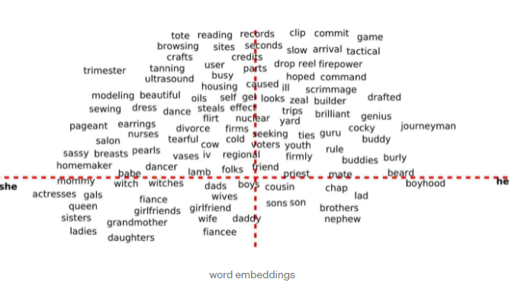
Natural Language Processing

Slide 3
Word2Vec
Concept:
We have a large corpus of text.
Every word is fixed in a vocabulary is represented by a vector.
Go through each position t in the text, which has a center word c and context words o.
Use the similarity of the word vectors for c and o to calculate the probability of o given c.
Keep adjusting the word vectors to maximize this probability.

Slide 4
The two way to implement word2vec: Continuous Bag of Words(CBOW) and skip-gram

Slide 5
Skip-Gram
Is one of the unsupervised learning technique used to find the most related words for a given word.
Used to predict the context word for a given center word.
Center word is the input and context word is the output.
If there is more than one context word to be predicted : Task is difficult

Slide 6
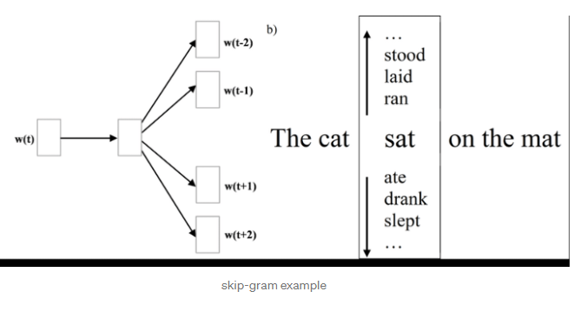

Slide 7
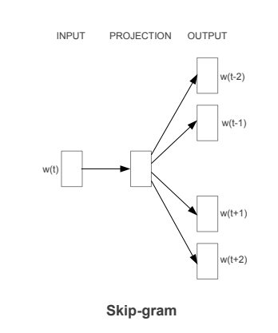
Architecture

Slide 8
W(t) is the center word or input given.
One Hidden layer which performs the dop product between the weight matrix and the input vector w(t).
No activation function has been used in the hidden layer.
Result of the dot product at the hidden layer is passed to the output layer.
Output layer computes the dot product between the output vector of the hidden layer and the weight matrix of the output layer.
Then we will apply SoftMax activation function to compute the probability of words to be the context of w(t) at a given context location.

Slide 9
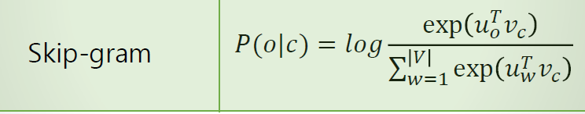
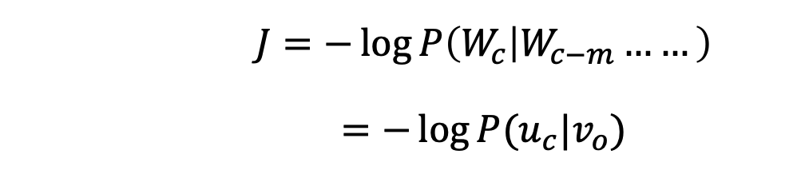
$$J=−\log{P\left(W_{c} | W_{c−m}……\right)}$$ $$=−\log{P(u_{c}|v_{o})}$$
P(o|c): Predicts context word using the center word

Slide 10
Advantages
It is unsupervised learning hence can work on any raw text given
Requires less memory comparing with other words to vector
representations.

Slide 11
Disadvantages
Softmax function is computationally expensive.
The time required for training this algorithm is high.

Slide 12
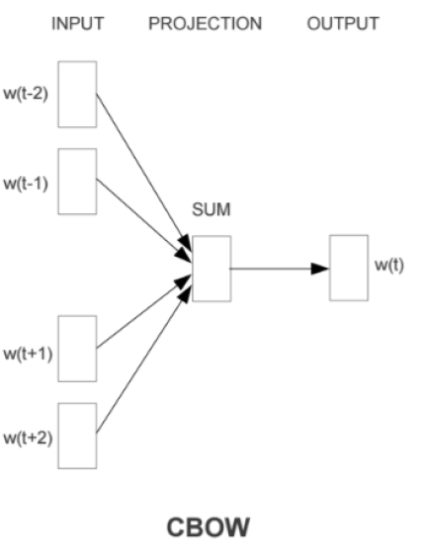
CBOW
It predicts a center word using context word.
Sum of the background vectors.
It calculates the average of the context vectors.

Slide 13
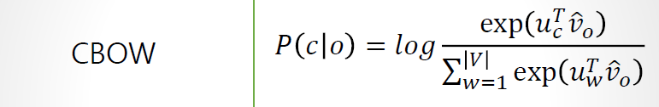
P(c|o) maximization: Predicts context words using center word.

Slide 14
Conclusion
The training samples consisted of a pair of words selected based on proximity of occurrence.
The last layer in the network was a soft-max function.

Slide 15
Negative Sampling
Apply SoftMax in output layer.
In case of 100,000 words, the calculation of soft-max will be huge.
Hence negative sampling allows to target through sampling only a few words.
Extracts the negative examples to reduce the number of weights
Apply softmax only to remaining layer.

Slide 16
Glove(Global vectors for word Representation)
It’s a hybrid of count based and window-based models.
The inner dot product of two embedded word vectors is defined as the probability of simultaneous appearance in the whole corpus.
Learning the whole corpus with ratios of probabilities can give better predictions

Slide 17
Advantages:
Fast training: Unlike window-based models, where we used to optimize one window at a time, in Glove we just optimize one count at a time.
Small corpus and small vector size.

Slide 18
HOMEWORK
Implement your own word2vec(skip-gram) model in python.

